Slide 1
SCHOOL TRAINING 2019-2020
District Contact Information
Dr. Peter Straker: peter.straker@osceolaschools.net ext 66016
Britt Bell: britt.bell@osceolaschools.net ext 66017

Slide 2
SAC Member Requirements
SAC
It is the School’s responsibility to ensure that all SAC Members are OASIS approved volunteers in accordance with Section 943.04351, F.S.

Slide 3
Florida Statute 1001.452 SAC Membership
SAC
Principal membership is mandatory
All voting members must be chosen or elected by peers.
Teachers elect teachers
Support staff elect support staff
Parents elect parents
Principals can appoint community members
The composition must represent the racial, ethnic and economic status of the school community
Assistant Principals can attend SAC meetings but cannot be a SAC Member or a Board Member e.g. SAC Chair, Secretary or Treasure

Slide 4
Florida Statute 1001.452 SAC Membership
SAC
Majority of the members are non-district employees (51%) (Use Compliance Calculator Tool to check)
Students of appropriate age are required to be members of SAC at the middle and high school level.
A completed SAC roster must be provided to the Office of School Improvement according to the district timeline.
If the SAC membership changes, an updated roster must be provided to the Office of School Improvement.

Slide 5
Responsibility of SAC
SAC
Each school advisory council shall adopt bylaws establishing procedures for:
1. Requiring a minimum of 8 meetings per year, in accordance with district policy.
2. Requiring a quorum to be present before a vote may be taken by the school advisory council. A majority of the membership of the council constitutes a quorum.
3. Requiring at least 3 days’ advance notice in writing to all members of the advisory council of any matter that is scheduled to come before the council for a vote.
4. Scheduling meetings when parents, students, teachers, businesspersons, and members of the community can attend.
5. Replacing any member who has two unexcused consecutive absences from a school advisory council meeting that is noticed according to the procedures in the bylaws.
6. Recording minutes of meetings and all meeting minutes, meeting agendas, and meeting attendance should be emailed to the Office of School Improvement (Rachelle Fougere) by the following month following the meeting.
Florida Statutes section 1001.452(1)(d)(4)

Slide 6
Florida Statute 1001.452 Primary Functions of SAC
SAC
To assist in the preparation and evaluation of the School Strategic Improvement Plan (SSIP) by giving insight and feedback
To assist in the preparation of the school budget.
To assist in the completion of the Mid-Year Review of the SSIP by giving insight and feedback
To encourage innovation at the school
To perform other functions as requested by the School Board and principal.

Slide 7
Superintendent’s Parent Leadership Cadre
All schools feed into the Superintendent’s Parent Leadership Cadre.
SAC chairs make up the Superintendent’s Parent Leadership Cadre or Designate.
Superintendent’s Parent Leadership Cadre meets 4 times per year.
In 2019-2020 the goal is to have representatives (recommended parent or community member) from each school to be present at each of the Superintendent’s Parent Leadership Cadre Meetings. (A wealth of information is shared in a two way conversation.)

Slide 8
School Advisory Council Mini Conference
Date October 14, 2019 from 5:00pm – 7:30pm
Registration Begins @ 4:30pm
Dinner will be provided
Osceola School of the Arts - Expo Hall

Slide 9
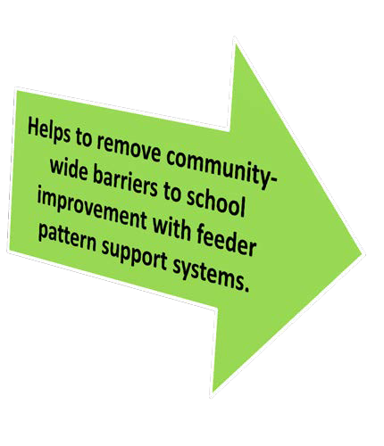
Making Connections
School Advisory Council
Superintendent's Parent Leadership Cadre
(Support from District Staff)

Slide 10
Mid-Year Expectations
SAC
Meaningful stakeholder input is vital to the school and district.
Each School Advisory Council (SAC), in cooperation with various identified community stakeholders that work with the school, is to conduct an annual midyear reflection as part of the SIP process and submit to FLDOE through the CIMs Platform.
Agenda and minutes will be submitted to the Office of School Improvement in January 2019

Slide 11
School Improvement Funds
Funds can be used for School Improvement Plan development or implementation only.
SACs must reference specific objectives and/or strategies in the School Improvement Plan.
The School Advisory Council decides on how the School Improvement Funds will be spent.
SAC funds must be spent on the needs of the individual school and cannot be transferred between schools.
The principal may not override the recommendations of the SAC.
School Improvement Funds may not be used for capital improvements, such as, construction, renovation remodeling, or site improvement.
SACs are encouraged to use the funds to meet current needs rather than having the monies committed to recurring needs, but SAC can approve recurring needs if voted on.
Fund expenditures should be reflected in the SAC minutes with signed documentation sent to the budget department.

Slide 12
School Recognition Funds
All selected schools shall receive financial awards depending on the availability of funds appropriated and the number and size of schools selected to receive an award.
Funds must be distributed to the school’s fiscal agent and placed in the school’s account and must be used for purposes listed in subsection (5) as determined jointly by the school’s staff and school advisory council.
If school staff and the school advisory council cannot reach agreement by February 1, the awards must be equally distributed to all classroom teachers currently teaching in the school. Sec. 1008.36(4) F.S.
Fund expenditures should be reflected in the SAC minutes with signed documentation sent to Human Resources

Slide 13
Tentative Dates July – September, 2019
Hold School Advisory Council (SAC) Elections
Record election results in SAC minutes
Ensure all FY19/20 SAC voting members have been added on the SAC Membership Compliance form and recorded in minutes and submitted to Office of School Improvement
Review Sunshine Law, Roberts Rules and SAC By- Laws with SAC members and recorded in minutes
SAC Checklist Completed and submitted to Office of School Improvement

Slide 14
SAC
September, 2019
School Improvement Plan SAC approval and recorded in minutes
October, 2019
School Principals Peer Review of School Improvement Plans
School Improvement Plan review and feedback provided by Office of School Improvement
November, 2019
School Board Approval as required by SB Policy 2.09 (8e)
January, 2020
Mid-Year Reflection submitted to FlDOE CIM Platform
School Improvement Plan Assurances (District)
May, 2020
Reflection on School Improvement Plan

Slide 15
Monthly Meetings to Include Agenda Item
SAC
S
Update on 2019-20 SIP Areas of Focus and Action Steps (positives and concerns)and changes made
Feedback to be recorded in Minutes

