Slide 1
Welcome to Poinciana High School!

Slide 2
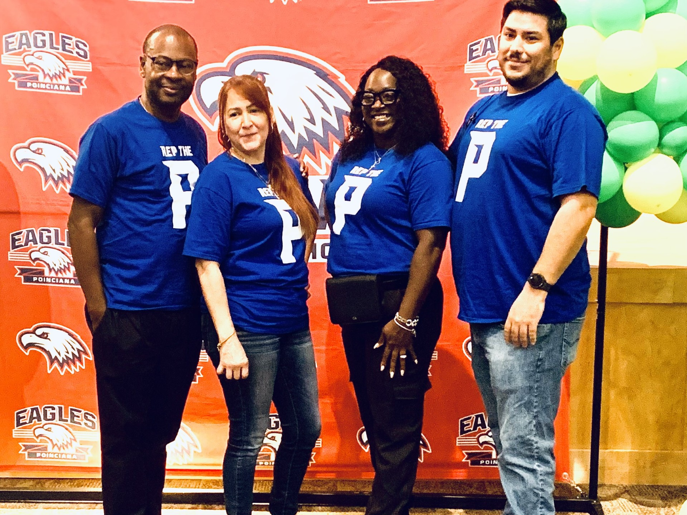
Meet Student Services
Ms. Cruz-Pagan –Dean’s Office Secretary
Mrs. Woechan – Asst. Principal of Student Services
​ LAST NAMES ​ | ​ DEAN ​ | ​ EXTENSION ​
​ A-D ​ | ​ Robinson ​ | ​ 83108 ​ ​
​ E-L ​ | ​ Clark | ​ 83106 ​ ​
​ M-Q ​ | ​ Gonzalez | ​ 83109 ​
​ R-Z ​ | ​ Scott ​ | ​ 83107 ​ ​

Slide 3
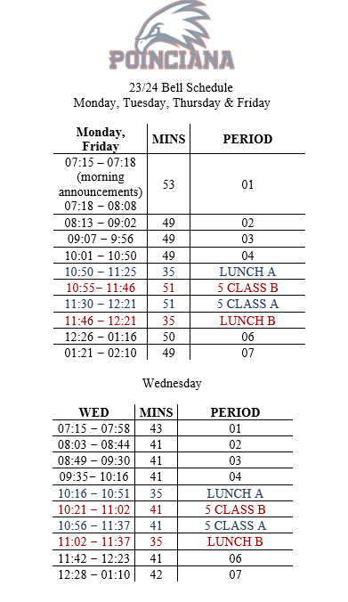
24-25

Slide 4
Tardy Slips
If a student arrives late to class, they may enter ONLY if they have a tardy slip.
If you do not have a tardy slip… please go to Student Services or a nearby administrator for a pass.
Students Exiting from the gym, building 14, and portables will be released (2) mins. early
Students will not receive an extra 2 minutes to arrive to the gym, bldg 14, and portables.
Tardies to class will be tracked in Hero and consequences will be given for excessive tardies.

Slide 5
Tardy to School
Students you are allowed (5) Tardies to school before you receive a Consequence.
6th Tardy to School will result in a Tardy Agreement sent home to your parents
7th Tardy to School will result in Insubordination Referral
8th Tardy to School will result in Defiance and you will be Suspended Out of School (1) day OSS

Slide 6
PANTS / Bottoms
Colors that are NOT Allowed
Gray
White
Green
Red
Brown
Camo
Patterns
Designs

Slide 7
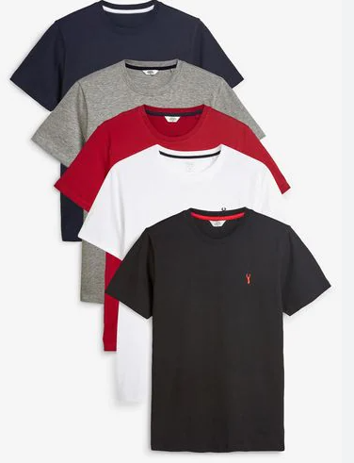
T-Shirts!!!
Students will be allowed to wear Poinciana High School spirit shirts/REP the P shirts any day of the week!
Solid White, Navy Blue, Red, Black or Gray T-Shirts are allowed any day of the week. (No V-Neck/Scoop Neck T-Shirts)
Shirts must be official (sports teams, clubs etc..)
Shirts may not be altered in any way.
Shirts with a Design (Large Print) is not Allowed
Shirts should be an appropriate length: mid-riff must be covered

Slide 8
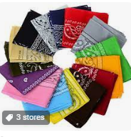
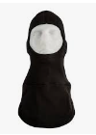
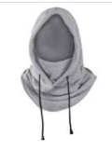
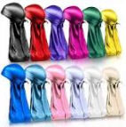
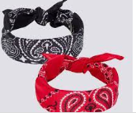
Not Allowed
No hoods, caps, hats, or headgear will be allowed on inside of any classroom or school building.
There will be immediate consequences for any student that fails to follow this procedure. This is your warning!
Jewlery with Inappropriate designs are not allowed!
School Administration have the final say in ALL dress code matters!

Slide 9
Please be RESPECTFUL and remove your sunglasses/shades once you are inside any building
Classroom
Cafeteria
Gym
Auditorium
Etc.

Slide 11
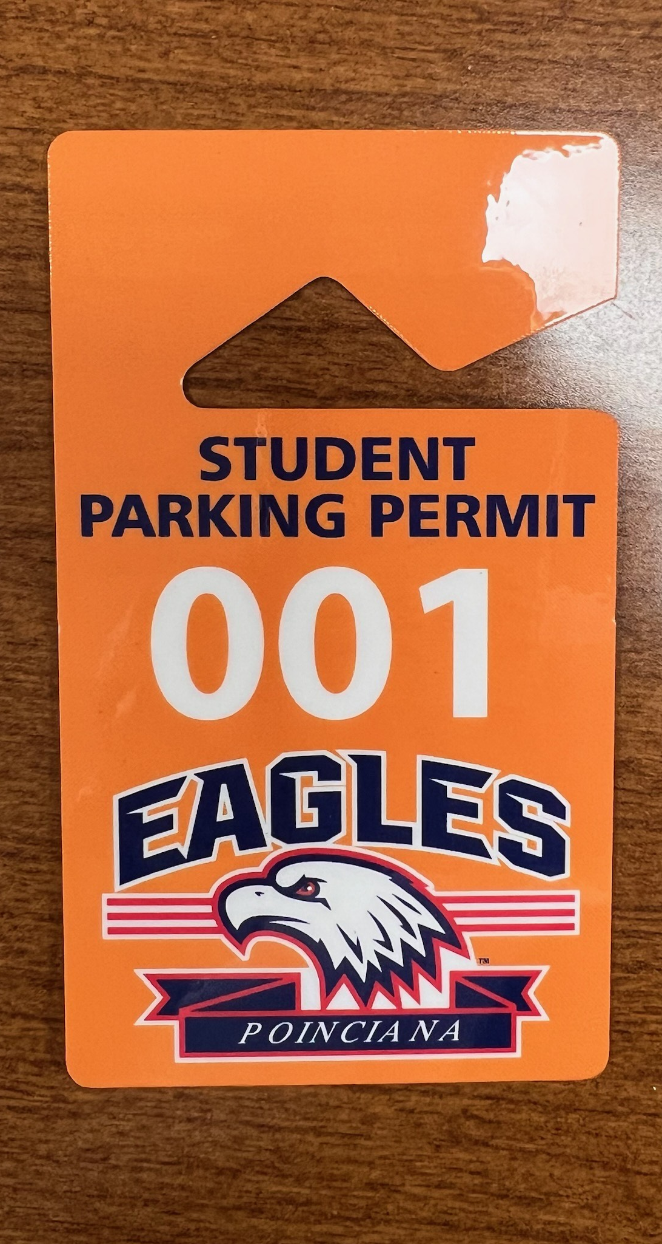
Student Parking-Fee $35.00
If you drive to school, you must have a parking pass visibly displayed.
Juniors and Seniors ONLY!
Please see Ms. Cruz in Student Services (Dean’s Office) to get a parking application before school and after school
You must have a valid Driver’s license not a restrict permit
If a student does not have their Original Parking pass there will be a $50.00 fee & possible Towing
Parking pass can be revoked for attendance and/or discipline issues.

Slide 12
No Off-Campus Lunch Passes this School Year!!!

Slide 14
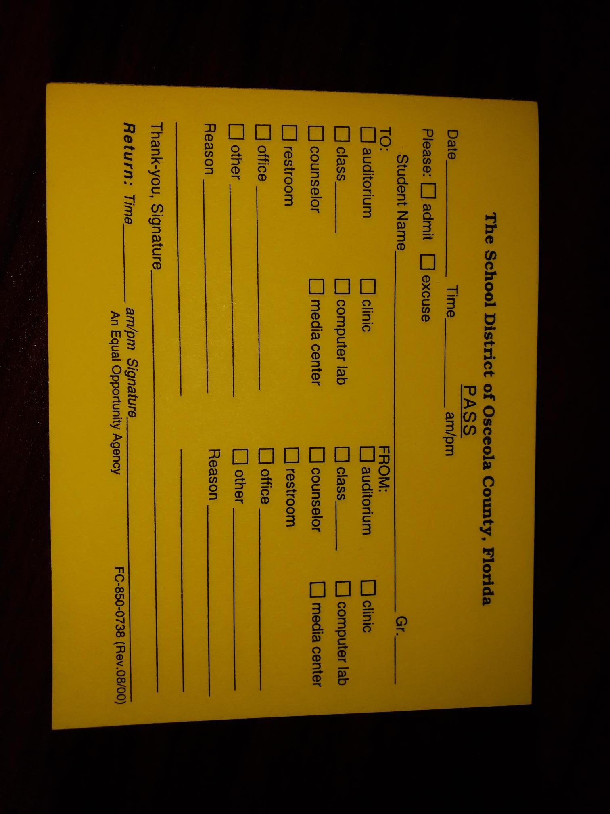
Lunch
If you want to see a teacher for academic purposes during lunch, you MUST have a pass, filled out and signed by a teacher.
If you do not have pass, you will not be permitted to leave the lunch area
Please stay within the indoor/outdoor cafeteria areas.
Do not sit on lunch windows.
Please do not sit in front of Automotive, Construction, Band, and Chorus.
There is no eating at any of the hallways
Please place trash in trashcans.
Do not leave lunch trays on the table.
Basketball will be allowed every day of the week. However, if trash is left on the court it will be cancelled the following day. Please take pride in our new court.

Slide 15
Transition/End of Day
It is extremely important to make an effort to move quickly, but carefully to your next class.
At the end of the day please move directly to your exit point. Busses do not wait. Busses will depart by 2:18. At dismissal ALL EXITS are ONE way!
Please go directly to your designated area. No students should be “hanging out” in the outdoor cafeteria area after school.
Please visit: businfo.Osceola.k12.fl.us to find bus information
Enter your address and find your bus number before the end of the day.

Slide 16
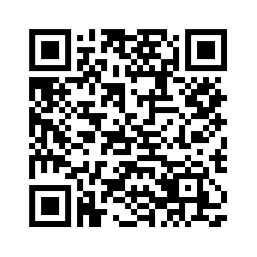
Here Comes the Bus
A new app you can download from the Apple & Google play store
School code 73760
This app has your barcode to get on and off the bus
The app will notify you if your bus is late or changed due to emergency

Slide 17
P.B.I.S. @ Poinciana High School
POSITIVE BEHAVIOR INTERVENTION AND SUPPORT

Slide 18
What is P.B.I.S.?
PBIS is used school wide
Positive Behavior Expectations with incentives and consequences
Recognition system for students and teachers doing the right thing

Slide 19
The Role of the Teacher
The Role of the Student
Students “Rep the P” by following the rules and expectations.
Teachers play a pivotal role in developing, implementing and nourishing a healthy school culture. They:
• Define expectations
• Teach the expected behavior
• Review expectations regularly
• Monitor performance of expected behaviors
• Recognize individuals when expected behaviors are demonstrated
• Re-teach the expected behaviors to students as needed.
R - RESPECT
E – EDUCATION
P - PRIDE

Slide 20
What does Respect look like?
Listen to reasons and explanations before you react
Avoid situations and gossip that have nothing to do with what matters in life (family, friends, health, and success)
Treat others as you would like to be treated (Golden Rule)
Assist those people you see that are in need of some help

Slide 21
What does Education look like?
Take advantage of every opportunity to learn and help your grade by completing all assignments
Replace social media engagement with engagement in learning critical content
Support the learning of each other to collectively improve the class
Become task-oriented by completing the work first and then reward yourself with relaxation time

Slide 22
What does Pride look like?
Choose behaviors that protect the school facilities and keep campus clean and classy
Commit to actions that leave a positive legacy and inspire others to choose the same positive behaviors
Speak positively about and defend the good things occurring at Poinciana High School
Hold others accountable for protecting facilities and choosing behaviors that make things better for themselves and others
Take time and perspective to appreciate and enjoy all accomplishments, no matter how big or small

Slide 23
P.B.I.S. Events!
Once a month, the P.B.I.S. team will sponsor an event for those students who have earned enough Hero points to participate. Those events include:
Food and drink
Sports events
Ice cream
“Rep the P” shirts
Popcorn
Cotton Candy
Basketball Fridays
And more . . .

Slide 24
P.B.I.S. Student of the month!
Student of the month!
Student who earns the most Hero points each month will be rewarded with:
School morning announcement
Certificate of recognition
“Rep the P” T - shirt

Slide 25
What is HERO?
HERO is a school wide web-based program that we use at Poinciana High School to:
Track: Tardy to School, Tardy to Class, Dress Code Violation & Unauthorized Area
Positive Reward-HERO points
Parent Communication

Slide 26
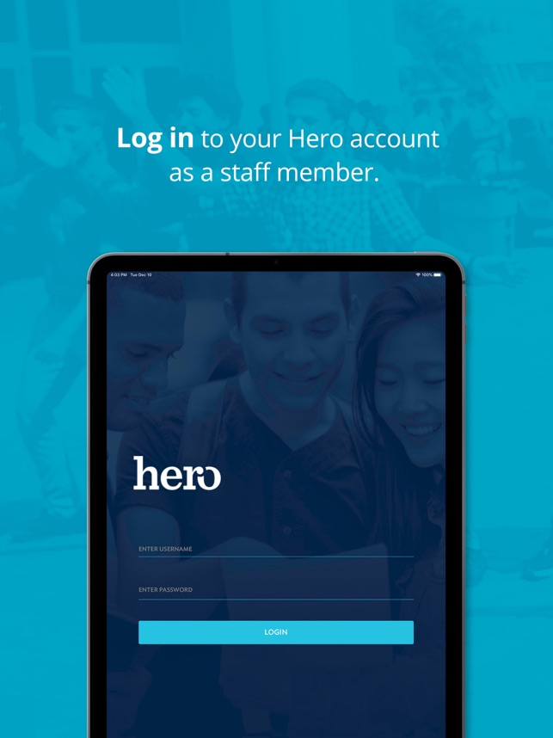
Student HERO access
Initial Log-in must be done on the computer:
access.heropowered.com/school/login
If you are new to the school, you must create an account
If you are returning you can use your credentials from last school year
If you forgot your password, you could click on the forgot password link
Download the Hero student app A.S.A.P. to keep track of points

Slide 27
Athletics
If you plan on playing a sport this year, you must maintain at least a 2.0 GPA!
No exceptions!
Your coach will be notified if you receive any days of ISS or OSS. You may not attend a game or practice if you are given OSS that day and on the day(s) you have OSS.
Discipline issues can result in loss of participation in games and or activities.

Slide 28
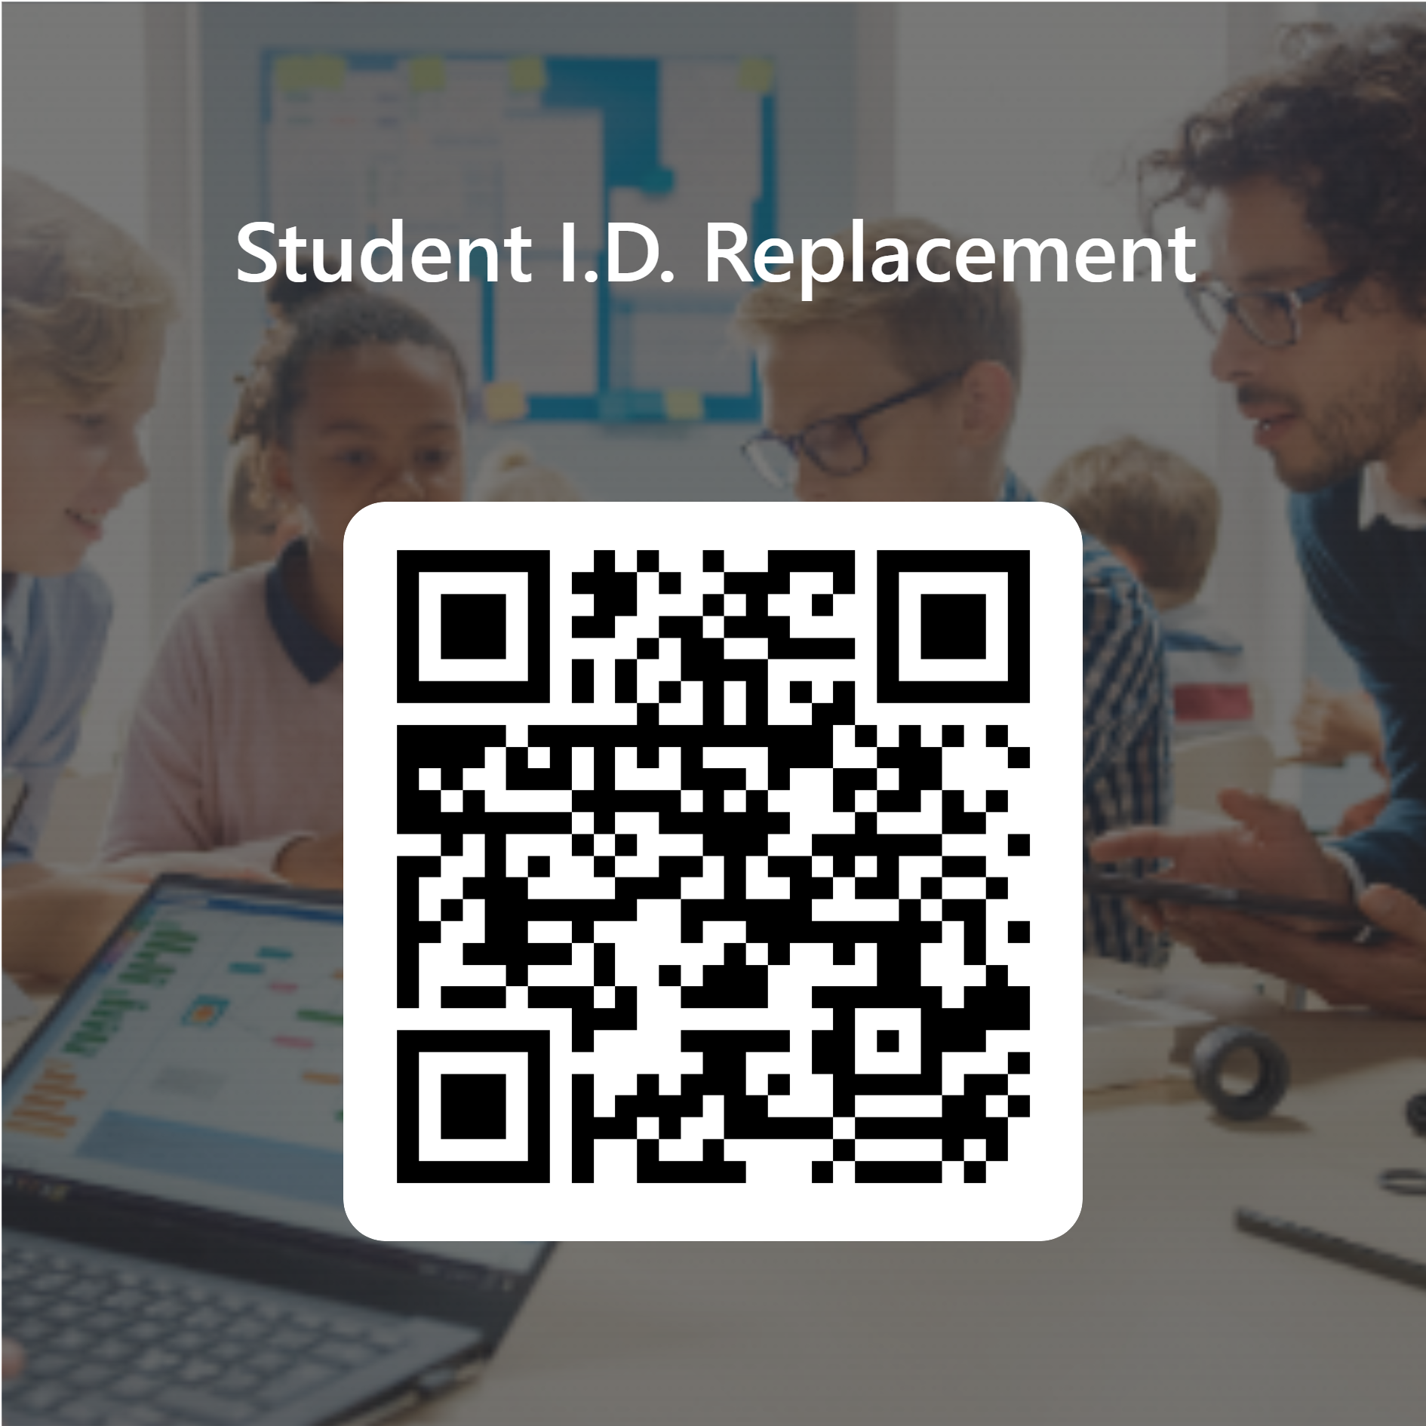
Student ID's
All 9th Grade student ID’s will be printed and delivered to your ELA Class.
10th-12th Replacement ID's Please fill out this form and it will be delivered to you.
If you need an ID for the Bus- Download
(Herecomesthebus) App

Slide 29
Standards of Participation
Not meeting the Standards of Participation will prevent you from going to the following: Athletic Events, Homecoming, Prom, & Field Trips
No more than 5 full days of ISS (in-school suspensions)
No referrals for excessive tardies each quarter (excessive tardies are 8 or more in a quarter)
No more than 5 unexcused absences from school each quarter, a total of 20 unexcused absences per school year
No more than 5 unexcused absences from each class period each quarter (considered skipping or Unauthorized area)
2.0 Minimum cumulative GPA
If a student has 9 or more OSS for the full school year, they cannot complete an appeal form.

Slide 30
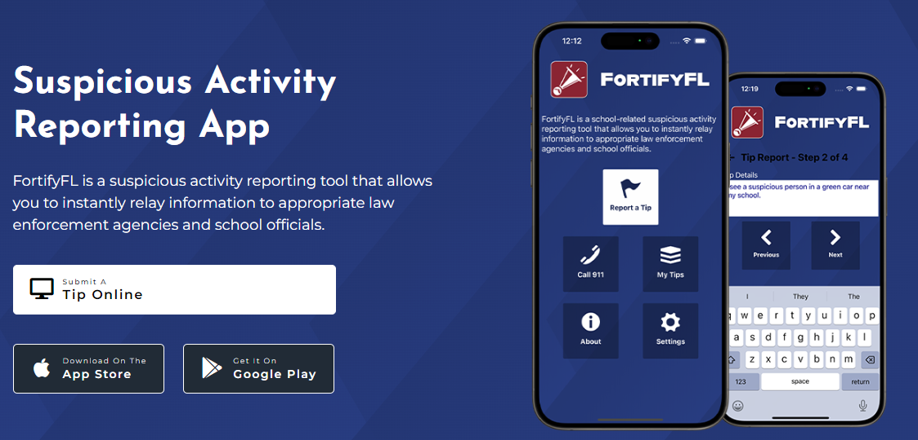
FortifyFL: getfortifyfl.com

Slide 31
FORTIFYFL

Slide 32
Active Assailant

Slide 33
Talk to me Nice
If you are stopped by Any Administrator or staff member
Please give us your undivided attention
Be patient with us
We promise to Talk Nice to you & We need you to Talk Nice to Us
If you fail to cooperate, you will be in Defiance, and your Consequence will be Elevated to a
Level 3-See a Dean

Slide 34
Remember to always REP the P.
This is YOUR school. And we ALL work together to take care of it and each other.
Respect
Education
Pride

Slide 35
Thank You!

